Slide 1
Promoting Science and Technology Exchange using Machine Translation
Toshiaki Nakazawa
Japan Science and Technology Agency
Oct. 30, 2015 @ PSLT2015

Slide 2
Topics Today
Introduction
Practical J-C MT Development Project by JST
2nd Workshop on Asian Translation (WAT2015)

Slide 3
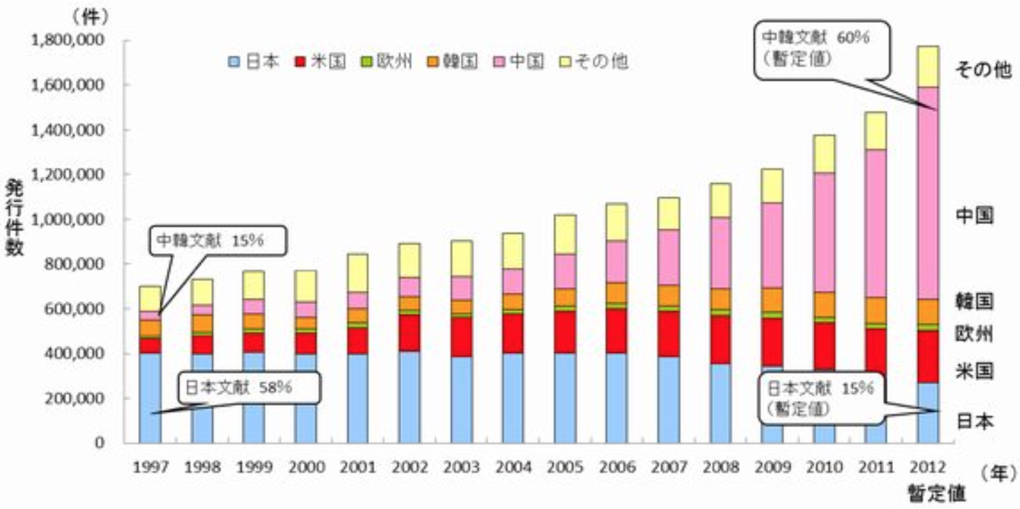
Number of Patents in the World
Ohters
China
Korea
Europe
USA
Japan
http://www.meti.go.jp/press/2014/11/20141112003/20141112003.html

Slide 4
Number of Scientific Papers
USA
China
Japan
* JST has calculated from “Web of Science” by Thomson Reuters

Slide 5
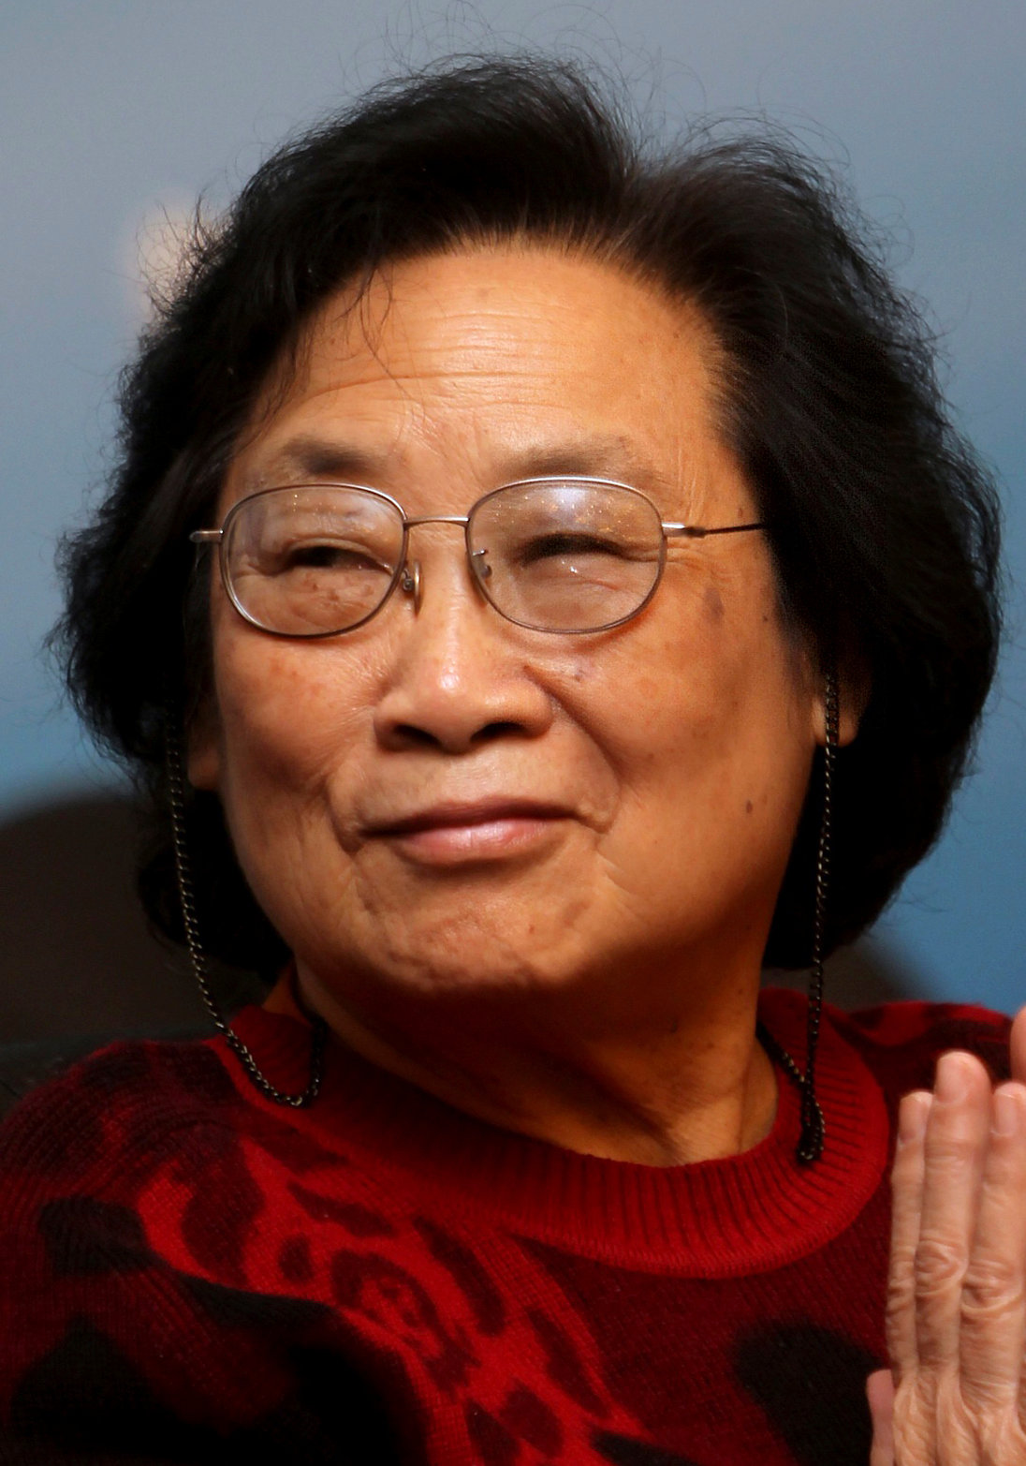
Q. Who is she?
Tu Youyou (屠 呦呦)
The first Chinese scientist to win a Nobel science award (Physiology or Medicine) in 2015
Turned to ancient texts in China and discovered clues for the anti-parasitic drugs
Photo from The New York Times

Slide 6

Frontrunner 5000
http://f5000.istic.ac.cn
Issued by Institute of Scientific and Technical Information of China（ISTIC）
Selected 315 outstanding journals
among 4600 journals in China
Further selected 5000 outstanding
papers from each scientific field
Abstracts are written in English, but the contents are in Chinese
  Less access from abroad

Slide 7
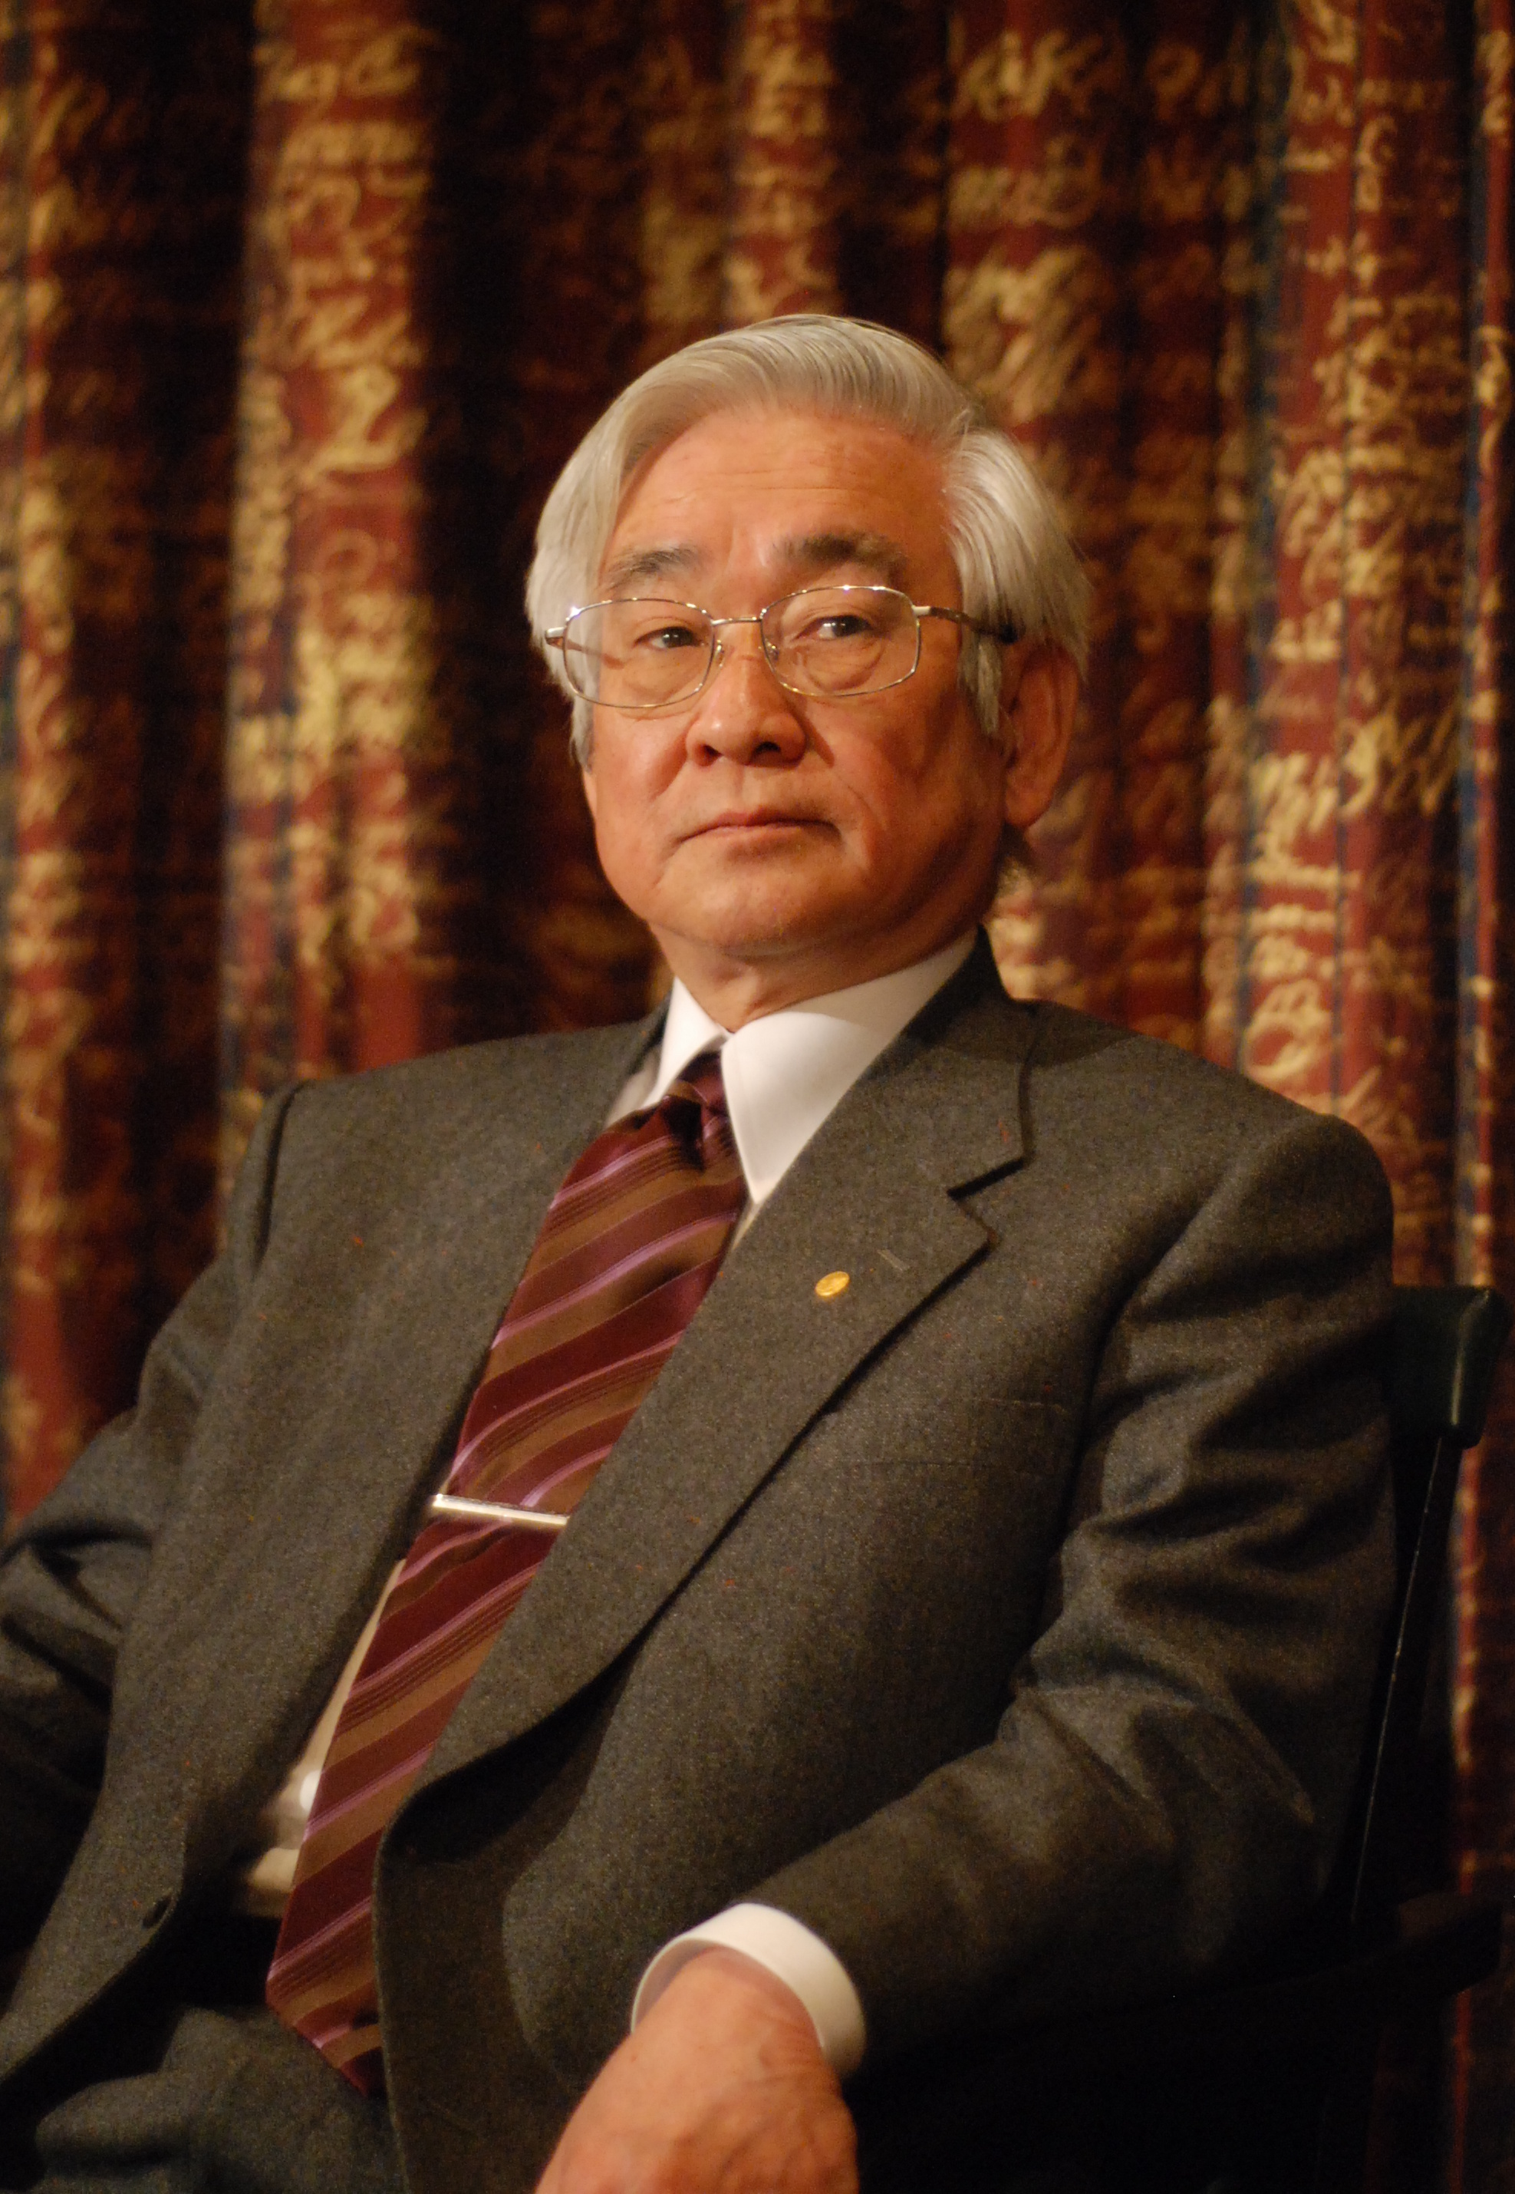
Q. Who is he?
Toshihide Maskawa (益川敏英)
Professor Emeritus at Kyoto University
Awarded the 2008 Nobel Prize in Physics
Extremely poor at foreign languages
  Made a Nobel Lecture in Japanese
  Poorly written English papers
Photo from Wikipedia

Slide 8
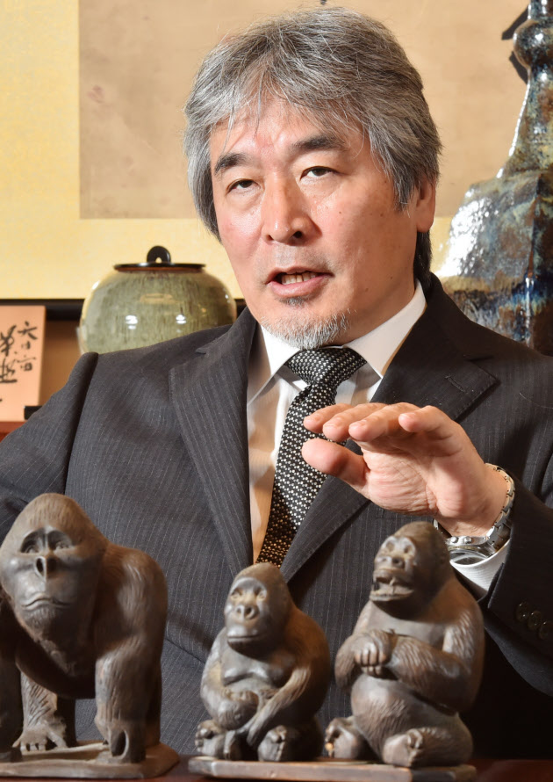
“English is just one of the tools”
Juichi Yamagiwa (山極寿一)
World-renowned expert in the study of gorillas
The current president of Kyoto University
“Thinking faculty can be obtained by thinking in their mother tongue (Japanese).”
Translate -> Think
Photo from Nikkei

Slide 9
Promoting the Information Access
Increasing number of documents written in other than English
Important information exists among them
MT is an essential tool for the easy access to the foreign information
  Chinese/Korean patent translation/search by JPO
  Practical J⬄C MT Development Project by JST

Slide 10
Topics Today
Introduction
Practical J-C MT Development Project by JST
  Language resource construction
    automatic dictionary construction [PACLIC2015]
  Sentence analyzers (dependency parser)
    accuracy on scientific papers
  MT engine development
    overview of KyotoEBMT
2nd Workshop on Asian Translation (WAT2015)

Slide 11
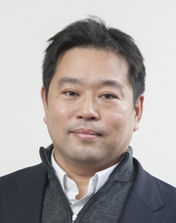
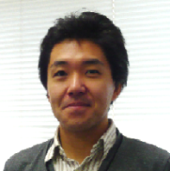

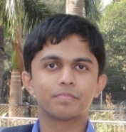
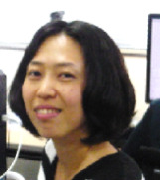
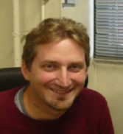
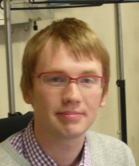

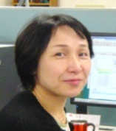
Project Overview
Period: 5 years from 2013
Participating organizations
  Japan: JST, KyotoU（supporting: Tsukuba U, NICT）
  China: ISTIC, CAS, BJTU, HIT
Break through the language barrier between Japan and China by MT and promote the science and technology exchange
http://foresight.jst.go.jp/jazh_zhja_mt/

Slide 12
Goal of This Project
Language Resource Construction
Sentence Analyzers
开发机器翻译技术
especially
for Chinese
Japanese Chinese
機械翻訳 机器翻译
アルゴリズム 算法
蓄積 积累
アセトン 丙酮
… …
ja: 原言語の意味を正しく目的言語に再現するためには，原言語表現の意味に適した訳語の選択が必要である。
zh: 为了能够正确的再现原来语言的意思，选择适合表现原来语言意思的译语是很重要的。
开发 机器 翻译 技术
Word Segmentation
开发
4M Technical Term Dictionary
5M Parallel Corpus
机器
Dependency Analysis
翻译
MT Engine Development
技术
Dictionary Construction
by pivoting:
NAACL2015
PACLIC2015
Word seg:
ACL2014 (short)
IJCNLP2013
Parsing:
PACLIC2012
Online Example Retrieving:
EMNLP2011
Decoding:
EMNLP2014
DEMO:
ACL2014
Example-based Machine Translation

Slide 13
Language resource construction

Slide 14
J-C Language Resources
Parallel Corpus
  Scientific Paper: 2M (including ASPEC, manual construction and automatic extraction)
    will be increased to 5M during the project
  Patent: 31M (automatic extraction)

Slide 15
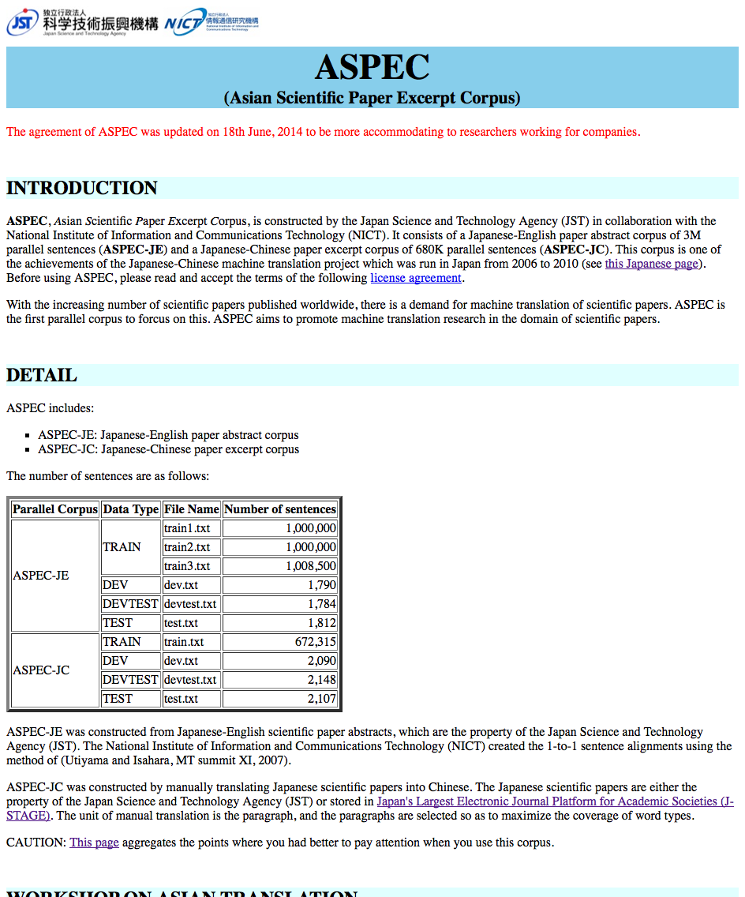
http://lotus.kuee.kyoto-u.ac.jp/ASPEC/
One of the fruits of the Japanese-Chinese machine translation project conducted between 2006 and 2010 in Japan
JE scientific paper abstract corpus
  3M parallel sentences extracted from 2M JE paper abstracts owned by JST
JC scientific paper excerpt corpus
  680K parallel sentences manually translated from Japanese papers which are stored in the e-journal site “J-STAGE” run by JST

Slide 16
J-C Language Resources
Parallel Corpus
  Scientific Paper: 2M (including ASPEC, manual construction and automatic extraction)
    will be increased to 5M during the project
  Patent: 31M (automatic extraction)
Parallel Dictionary
  Automatic construction using the existing resources
  3.6M entries (about 90% accuracy)

Slide 17


Large-scale Dictionary Construction via Pivot-based Statistical Machine Translation with Significance Pruning and Neural Network Features
Raj Dabre¹, Chenhui Chu², Fabien Cromieres²,
Toshiaki Nakazawa², Sadao Kurohashi¹
1: Kyoto University, Japan
2: JST, Japan
PACLIC2015

Slide 18
Overview
What we want: High quality, large size technical term dictionary
Why: Can be used as additional resource for MT or CLIR etc.
How: pivot based SMT (baseline, Chu+ 2015)
+ significance pruning
+ reranking by NN model
+ character-based OOV translation by NN

Slide 19
Dictionary Construction via Pivot-based Statistical Machine Translation (SMT) [Chu+ 2015]
Ja-En dictionary
Zh-En dictionary
Zh | 雪 | 爱 | 发
Ja | 雪 | 愛 | 発
Common
Chinese
characters
アダプター蛋白質 ↵ ||| adapter protein
・・・
乙酰化反应 ||| ↵ acetylation reaction
・・・
Ja-Zh dictionary
アダプター蛋白質 ↵ ||| 接头蛋白
アセチル化反応 ||| ↵
乙酰化反应
・・・
蛋白 質 ||| 蛋白 ||| …
アセチル 化 ||| 乙酰化 ||| …
Ja-Zh SMT
Ja-Zh corpus
・・・
Ja-Zh direct phrase table
アダプター ||| adapter ||| …
反応 ||| reaction ||| …
・・・
Pivoting
アダプター ||| 接头 ||| …
反応 ||| 反应 ||| …
Ja-En corpus
Ja-En phrase table
・・・
reaction ||| 反应 ||| …
adapter ||| 接头 ||| …
Ja-Zh pivot phrase table
・・・
En-Zh corpus
En-Zh phrase table

Slide 20
Noise Problem
Source-Pivot phrase table
アダプター ||| adapter ||| …
しかも ||| adapter ||| …
アダプター ||| 接头 ||| …
アダプタ ||| 承载鞍 ||| …
しかも ||| 接头 ||| …
しかも |||承载鞍 ||| …
反応 ||| 反应 ||| …
反応 ||| 合成 ||| …
計算 ||| 反应 ||| …
計算 ||| 合成 ||| …
反応 ||| reaction ||| …
計算 ||| reaction ||| …
・・・
Pivoting
reaction ||| 反应 ||| …
reaction ||| 合成 ||| …
adapter ||| 接头 ||| …
adapter ||| 承载鞍 ||| …
・・・
・・・
Pivot phrase table
Pivot-Target phrase table
In the pivot phrase table, the average number of translations for each source phrase is 10,451!

Slide 21
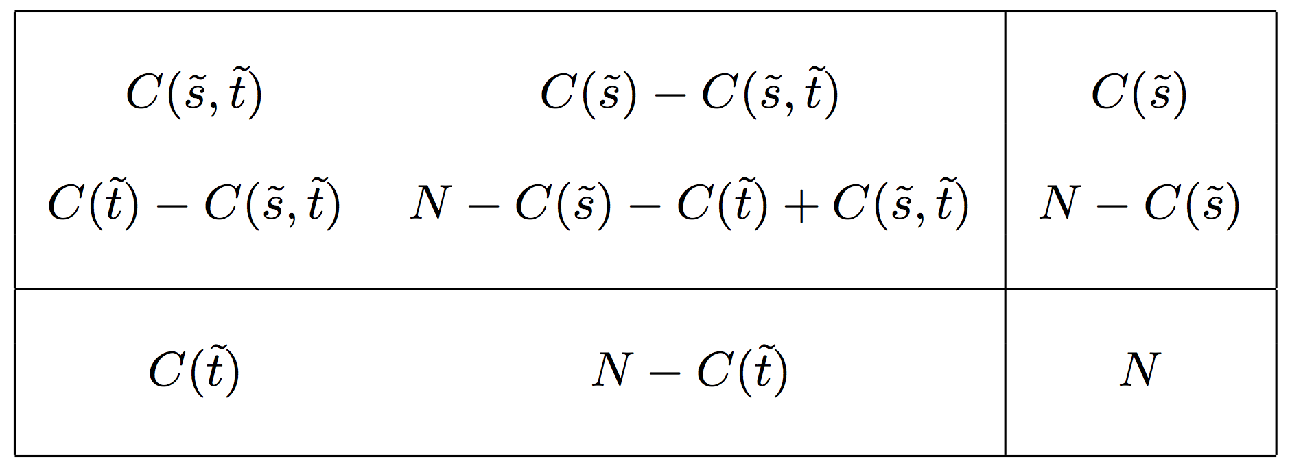
Significance Pruning (1/2)
[Johnson+ 2007]
Contingency table of phrase pairs in corpus
# parallel sentences containing phrase s, t
# source sentences containing phrase s
# target sentences containing phrase t
# parallel sentences

Slide 22
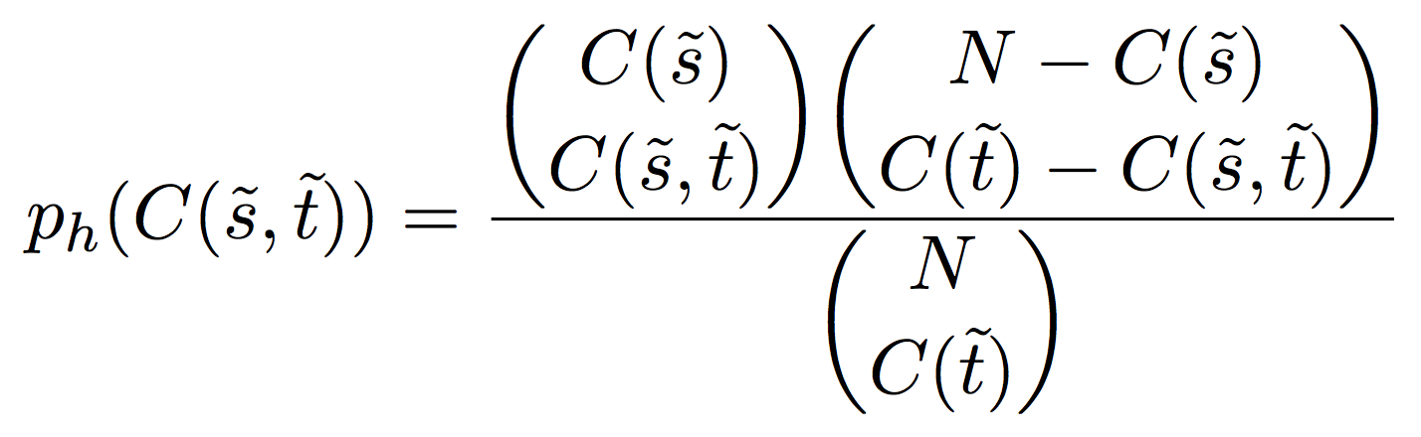
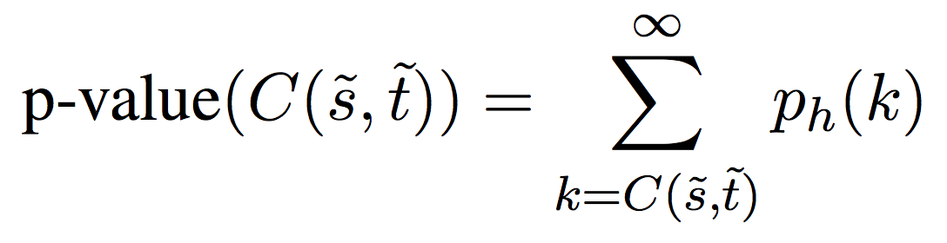
Significance Pruning (2/2)
[Johnson+ 2007]
Fisher’s exact test
Hypergeometric
distibution
Phrase pairs with a p-value larger than
a threshold are pruned
Notes:
Binomial coefficient. This probability is interpreted as the probability of observing by chance an association that is at least as strong as the given one and hence its significance. A larger C(s, t) means more extreme cases than the observed one.
a=log(N) for 1-1-1 tables

Slide 23
Reranking by NN model
ジアルキルアミン
(Dialkyl amine)
Ja-Zh dictionary
automatically constructed
by the baseline method
(3.6M entries)
二烷基仲胺 ||| -1.66314
二烃基胺 ||| -2.09771
アダプター蛋白質 ↵ ||| 接头蛋白
アセチル化反応 ||| ↵
乙酰化反应
・・・
二烷基酰胺 ||| -2.46545
・・・
Reranker with
neural features
Character based
model
二烃基胺 ||| -82.57215
二烷基仲胺 ||| -109.61948
二烷基酰胺 ||| -118.26405
Ja-Zh parallel corpus
(ASPEC, 680k)
・・・

Slide 24
Character-based NN Model
Learn character-based NN translation model for both translation directions
  Groundhog framework for learning
Model can be used also for the translation of OOV words

Slide 25
Dataset for Experiments
Bilingual dictionaries
Parallel corpora
Language | Name | Size
Ja-En (1.4M) | Wiki title | 361k
 | Med | 54k
 | EDR | 491k
 | JST | 550k
En-Zh (4.5M) | Wiki title | 151k
 | Med | 48k
 | EDR | 909k
 | Wanfang | 2.0M
 | ISTIC | 1.4M
Ja-Zh (561k) | Wiki title | 175k
 | Med | 54k
 | EDR | 330k
Language | Name | Size
Ja-En (49.1M) | LCAS | 3.5M
 | Abst title | 22.6M
 | Abst JICST | 19.9M
 | ASPEC | 3.0M
En-Zh (8.7M) | LCAS | 6.0M
 | LCAS title | 1.0M
 | ISTIC PC | 1.5M
Ja-Zh (680k) | ASPEC | 680k

Slide 26
Experimental Results
Method | BLEU4 | OOV (%) | Accuracy w/ OOV |  | Accuracy w/o OOV
 |  |  | 1 best | 20 best | 1 best | 20 best
1. Direct only | 40.84 | 26 | 0.3721 | 0.5255 | 0.5011 | 0.7082
2. Pivot only | 53.32 | 8 | 0.5038 | 0.7284 | 0.5470 | 0.7908
3. Direct+Pivot (1+2) | 54.52 | 8 | 0.5136 | 0.7367 | 0.5574 | 0.7994
4. 3 + Statistical Pruning* | 55.86 | 8 | 0.5303 | 0.7260 | 0.5755 | 0.7878
5. 4 + NN Reranking | 58.55 | 8 | 0.5566 | 0.7260 | 0.6040 | 0.7878
6. 4 + SVM Reranking | 55.28 | 8 | 0.5472 | 0.7260 | 0.5938 | 0.7878
7. 5 + OOV translation | 58.00 | 0 | 0.5588 | 0.7300 | - | -
8. 6 + OOV translation | 54.85 | 0 | 0.5494 | 0.7300 | - | -
* Only pivot-target phrase table is pruned
Evaluated on Ja-Zh Iwanami biology and life science dictionaries
(dev: 4,983 pairs, test: 4,982 pairs)

Slide 27
Underestimation Problem
Type | Ja term | References | Translations
1 | 粘質土 | 粘质土/黏质土 | 粘性土/软泥/黏土/粘质土/黏性土/亚粘土/粘质土壤/粘性土壤/黏性土地/粘土质
2 | チョウザメ類 | 鲟形目鱼类/鲟鱼类 | 鲟形目/鲟鱼/鱘科类/鲟鱼类/鲟类/鱘科亚纲/鲟鱼亚纲/鱘科化合物/鲟鱼化合物/鲟亚纲
3 | 心血管系デコンディショニング | 心血管脱适应/心血管脱锻炼 | 血管脱/心血管系统去条件化/心血管去条件化/去条件化心血管系统/血管去条件化/心血管系去条件化/去条件化心血管/去条件化的心血管系统/去条件化对心血管系统/心血管系统的去条件化
Type 1: top 1 is correct, but not covered by the references
Type 2: correct one is listed in top 20
Type 3: correct one is *not* listed in top 20
76% (38/50) of the errors belong to Type 1
=> actual 1-best accuracy is about 90%

Slide 28
Summary of Dictionary Construction
Using the proposed method, we constructed 3.6M dictionary by translating Ja-En and En-Zh dictionaries
Future work: Classify the dictionary into different domains
Open the dictionary to public soon
  improve the quality by crowd power
畸形 (Biology)
abnormity
反常 (Business Administration)

Slide 29
Sentence analyzers (dependency parser)

Slide 30
Chinese-Japanese
Scientific Paper Treebank
Selected 1000 parallel sentences from Ja-Zh scientific papers
HIT created Chinese treebank and Kyoto-U created Japanese treebank
Not enough for training the parsers, but useful to check the practical accuracy of parsers for scientific sentences
Not public now, sorry … ☹

Slide 31
Dependency Parsing Accuracy
Japanese: 88.3%
  Clause-level evaluation, starting from gold segmentation and POS-tag
  Lower than that for Web or newspaper by 2-3%
Chinese: 75.7%
  Starting from gold segmentation and POS-tag
  Root accuracy = 73.2%
  Sentence accuracy = 12.7%

Slide 32
Mt engine development

Slide 33
Overview of KyotoEBMT
Input:
例えばプラスチックは石油から製造される
Translation Examples
水素
the
は
hydrogen
現在
is
天然ガス
produced
plastic
や
from
is
例えば
natural
プラスチック
石油
gas
produced
は
から
and
from
製造
raw
petroleum
石油
petroleum
から
さ
for example
れる
at
製造
present
さ
プラスチック
れる
We
Output:
plastic is produced from petroleum
for example
を
investigated
調査
plastic
した
例えば
for example
・・・・・ ・・・・・

Slide 34
Specificities (1/2)
No “phrase-table”
  all translation rules computed on-the-fly for each input
  cons:
    possibly slower (but not so slow)
    computing significance/ sparse features more complicated
  pros:
    full-context available for computing features
    no limit on the size of matched rules
    possibility to output perfect translation when input is very similar to an example

Slide 35
Specificities (2/2)
“Flexible” translation rules
  Optional words
  Alternative insertion positions
  Decoder can process flexible rules more efficiently than a long list of alternative rules
    some “flexible rules” may actually encode > millions of “standard rules”

Slide 36
Flexible Rules Extracted on-the-fly
?
水素
the
は
hydrogen
現在
is
天然ガス
produced
例えば(for
example)
や
from
natural
プラスチック
(plastic)
石油
gas
は
から
and
製造
raw
石油
petroleum
から
さ
れる
at
製造
present
さ
X(plastic)
れる
is
Y(for example)
X: Simple case
(X has an equivalent in the source example)
Y: ambiguous insertion position
produced
Y(for example)
from
raw*
petroleum
“raw”: null-aligned = optional word
Y(for example)

Slide 37
Improvements from Last Year
Support forest input
  compact representation of many parses
  reduce the effect of parsing errors
Supervised word alignment using Nile
together with the dependency tree-based alignment model
10 new features
Reranking with Neural MT
(Riesa et al., 2011)
(Nakazawa and Kurohashi, 2012)
(Bahdanau et al., 2015)

Slide 38
BLEU Improvement

Slide 39
Better Representation for PE
[Kishimoto et. al, 2014 WPTP3]
Chinese analysis
考虑到
计算
的重要性
，
一般人口中发生肾上腺偶发肿瘤的概率
我们
调查了
Japanese translation in Chinese order
体检中发现肾上腺偶发肿瘤的
概率
。
を考慮して
を計算する
の重要性
一般人口に副腎偶発腫が発生する確率
，
我々は
を調査した
検診に副腎偶発腫を発現する
確率
。
を計算する
の重要性
を考慮して
，
一般人口に副腎偶発腫が発生する確率
我々は
を調査した
検診に副腎偶発腫を発現する
確率
。
Japanese Translation Result

Slide 40
Topics Today
Introduction
Practical J-C MT Development Project by JST
  Language resource construction
    automatic dictionary construction [PACLIC2015]
  Sentence analyzers (dependency parser)
    accuracy on scientific papers
  MT engine development
    overview of KyotoEBMT
2nd Workshop on Asian Translation (WAT2015)

Slide 41
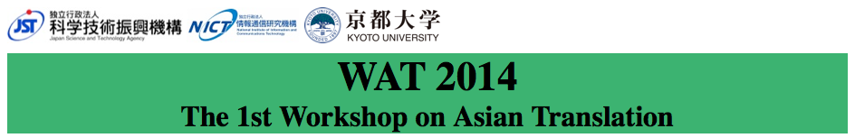
http://lotus.kuee.kyoto-u.ac.jp/WAT/
MT evaluation campaign focusing on Asian languages (Japanese, Chinese, Korean and English for now)
  Workshop was held the day before yesterday
Tasks:
  Japanese ⬄ English scientific paper (ASPEC)
  Japanese ⬄ Chinese scientific paper (ASPEC)
  Chinese, Korean -> Japanese patent (JPC)
All the data including test set are OPEN
  contribute to continuous evolution of MT research by freely distributing the data (like PennTreebank sec. 23)

Slide 42
Participants List of MT Tasks
Team ID | Organization | ASPEC |  |  |  | JPC
 |  | JE | EJ | JC | CJ | CJ | KJ
NAIST | Nara Institute of Science and Technology | ✓ | ✓ | ✓ | ✓
Kyoto-U | Kyoto University | ✓ | ✓ | ✓ | ✓ | ✓
WEBLIO_MT | Weblio, Inc. |  | ✓
TMU | Tokyo Metropolitan University | ✓
BJTUNLP | Beijing Jiaotong University |  |  |  | ✓
Sense | Saarland University & Nanyang Technological University | ✓ | ✓ |  |  |  | ✓
NICT | National Institute of Information and Communication Technology | ✓ |  |  |  |  | ✓
TOSHIBA | Toshiba Corporation | ✓ | ✓ | ✓ | ✓ | ✓ | ✓
WASUIPS | Waseda University |  |  |  |  | ✓
naver | NAVER Corporation |  | ✓ |  |  |  | ✓
EHR | Ehara NLP Research Laboratory |  | ✓ |  | ✓ | ✓ | ✓
ntt | NTT Communication Science Laboratories |  |  |  |  | ✓
company
outside Japan

Slide 43
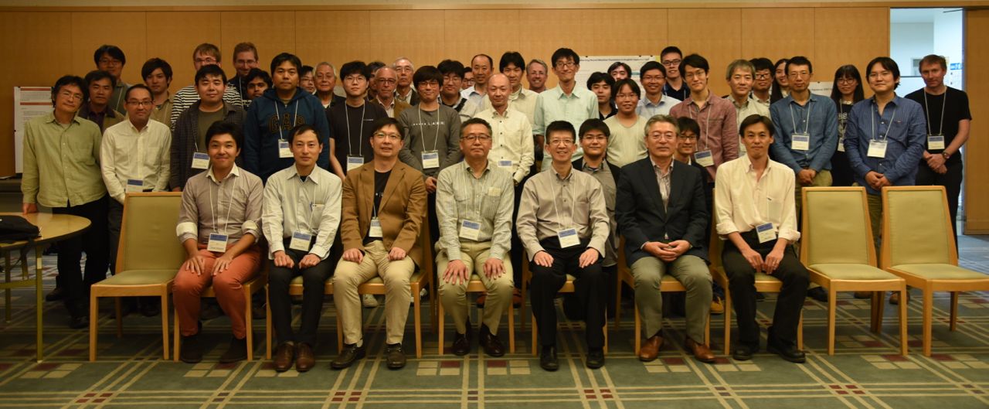
Over 50 audiences!

Slide 44
Human Evaluation in WAT2015
Pairwise Crowdsourcing Evaluation
  System output v.s. baseline output
  Evaluators judge win (1), loss (-1), or tie (0) for the system output
  5 evaluators assessed for each translation pair
  The final judgment for each sentence is decided by voting based on the sum of judgments:
    Win: sum ≧ 2, Loss: sum ≦ -2, Tie: otherwise
  Crowd score = 100 * (Win-Loss) / 400

Slide 45
Human Evaluation in WAT2015
JPO Adequacy Evaluation (NEW)
  Top 3 teams of each subtask according to the Crowd score
  5-scale criterion defined by Japan Patent Office
5 | All important informa7on is transmiced correctly. (100%)
4 | Almost all important informa7on is transmiced correctly. (80%〜)
3 | More than half of important informa7on is transmiced correctly. (50%〜)
2 | Some of important informa7on is transmiced correctly. (20%〜)
1 | Almost no important informa7on is transmiced correctly. (〜20%)

Slide 46
Findings at WAT2015
Neural Network based re-ranking is effective (NAIST, Kyoto-U, naver)
The top SMT outperformed RBMT for Chinese- Japanese and Korean-Japanese patent translation
Korean-Japanese patent translation achieved high scores for both automatic and human evaluations
A problem of automatic evaluation was found in the Korean-Japanese evaluation
For the detail, please visit
http://lotus.kuee.kyoto-u.ac.jp/WAT/
or search papers in ACL Anthology

Slide 47
Scientific Paper J->E

Slide 48
Scientific Paper E->J

Slide 49
Scientific Paper J->C

Slide 50
Scientific Paper C->J

Slide 51
Scientific Paper C->J

Slide 52
Patent C->J

Slide 53
Patent K->J

Slide 54
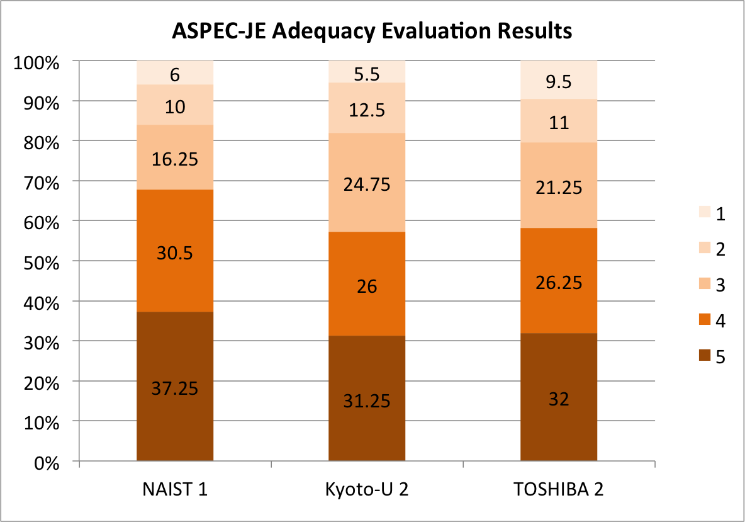
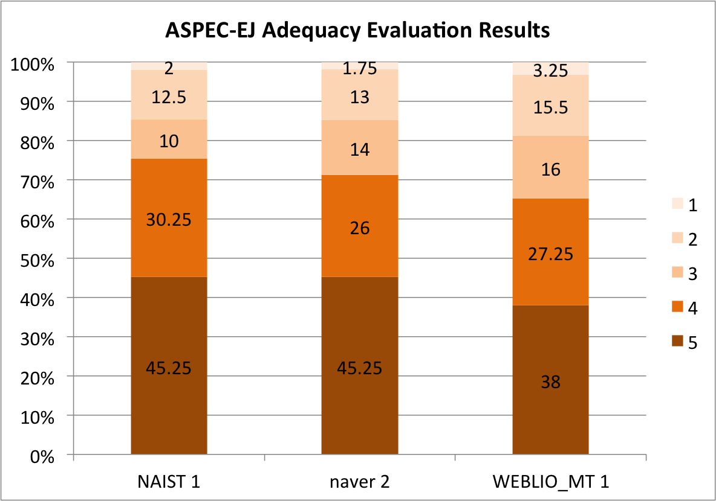
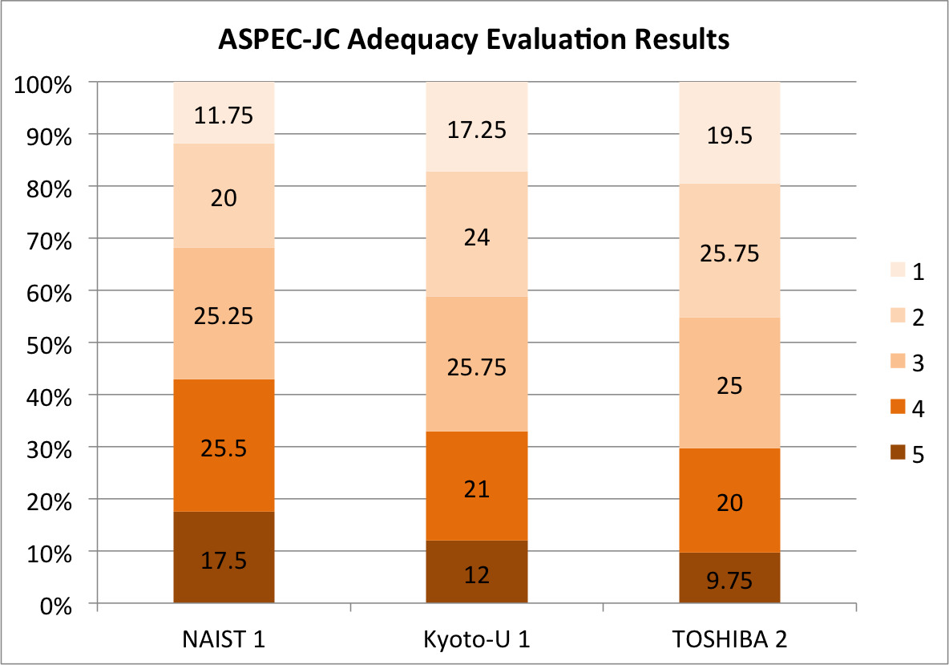
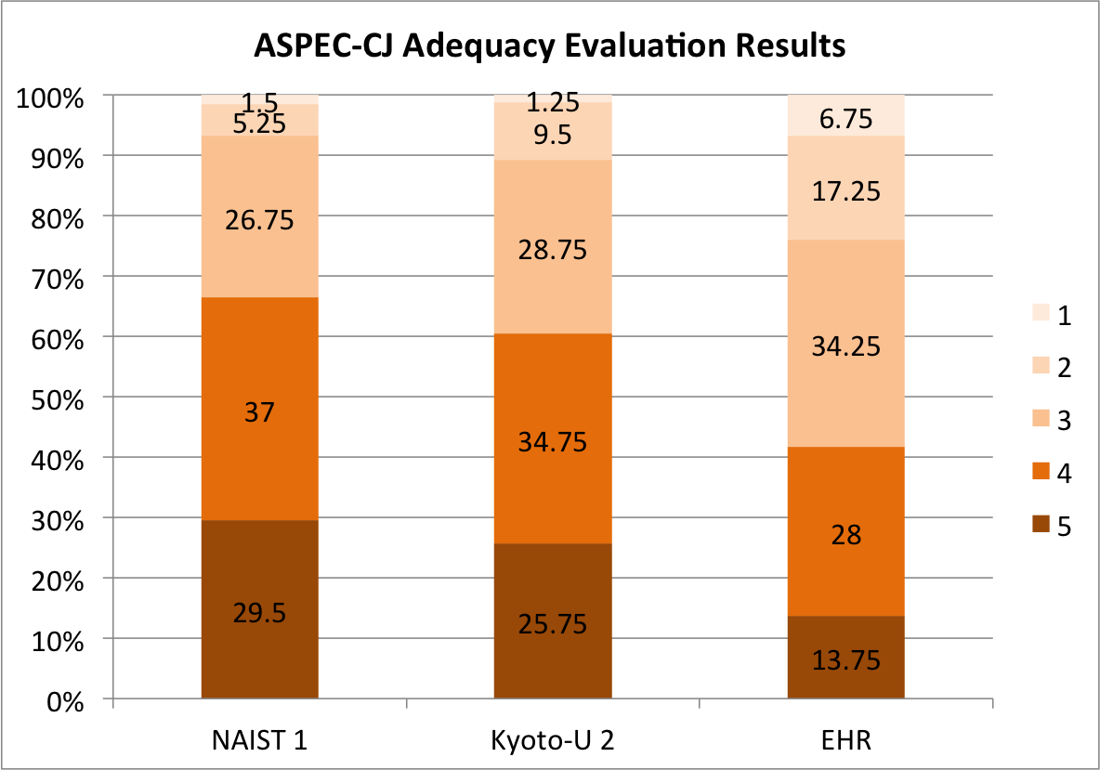
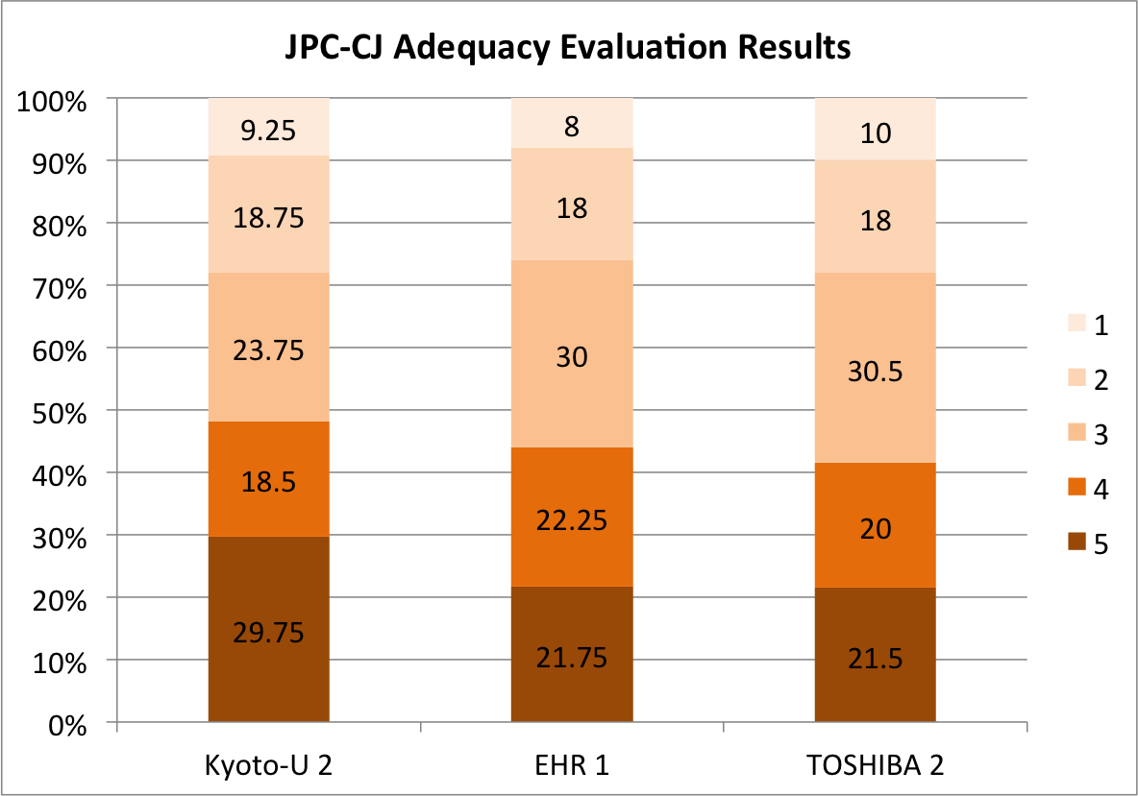
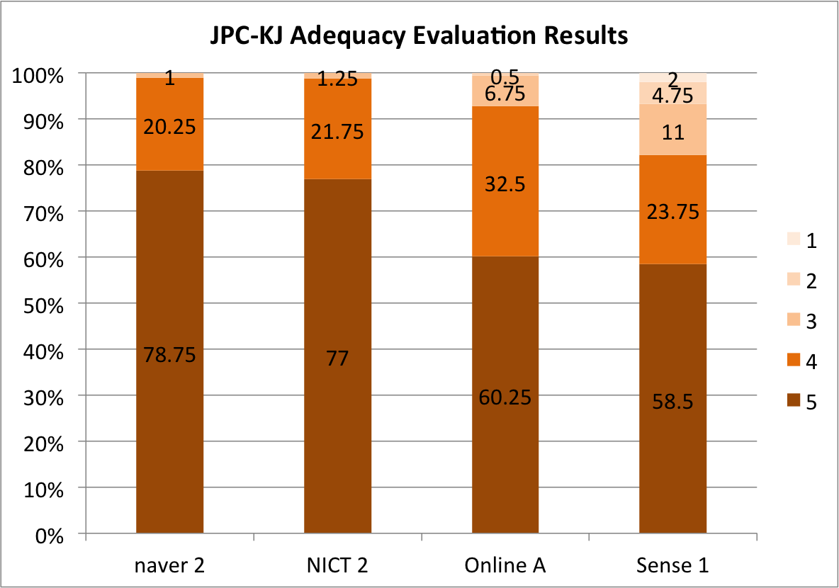
JPO Adequacy Evaluation Results

Slide 55
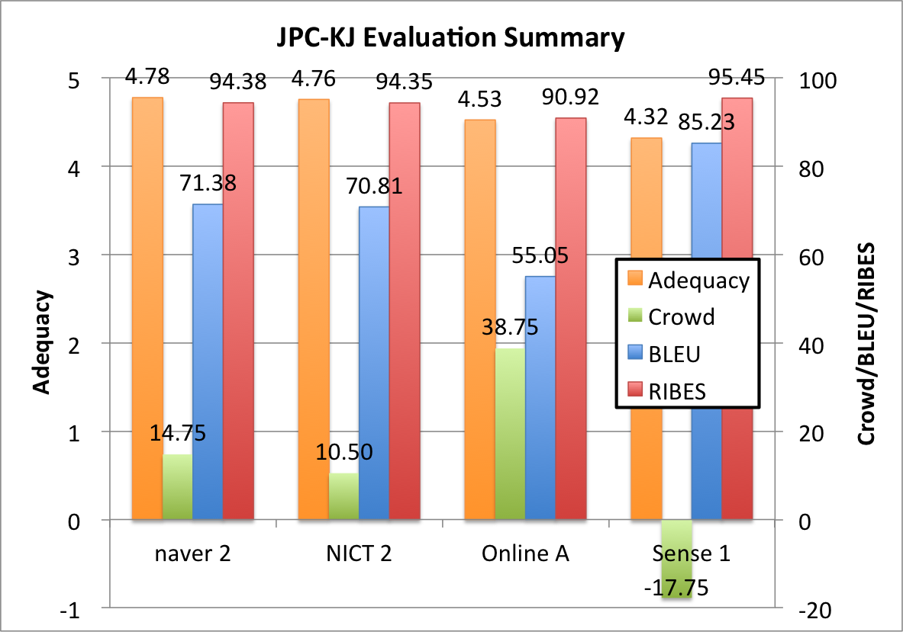
Problem of Automatic Evaluation
The highest automatic scores
The lowest crowd score

Slide 56
Next Step
WAT2016 will be co-located with Coling2016!
  Not decided yet…
Include new language pair!
  Indonesian-English
Need more investigation to acquire reliable human evaluation results at low cost

Slide 57
Summary
MT is an essential tool for the easy access to the foreign information
Our contributions
  J-C MT project to promote science and technology exchange between China and Japan
    Constructed and exchanged language resources
    Have been developing sentence analyzers and MT
  Workshop on Asian Translation
What’s next
  Make practical use of the developed MT system

Slide 58
Thank you for your attention!

