Slide 1
Alignment by Bilingual Generation and Monolingual Derivation
Toshiaki Nakazawa and Sadao Kurohashi
Kyoto University

Slide 2
Outline
Background & Related Work
Model Overview
Model Training
Experiments
Conclusion

Slide 3
Background
Alignment quality of GIZA++ is quite insufficient for distant language pairs
Wide range reordering, many-to-many alignment
En-Fr < 10% AER vs. En-Ja, Zh-Ja ≒ 20% AER
Fr: Il est mon frère .
En: He is my brother .
Zh: 他 是 我 哥哥 。
Ja: 彼 は 私 の 兄 です 。
AER: Alignment Error Rate

Slide 4
Tree-based Alignment Model
[Nakazawa+, 2011]
彼
He
C₁
は
is
C₂
です
私
my
C₃
の
brother
C₄
兄
Choose a number of components
Generate each of treelet pairs independently
Combine treelets so as to create sentences

Slide 5
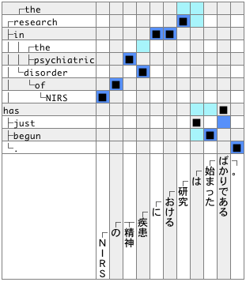
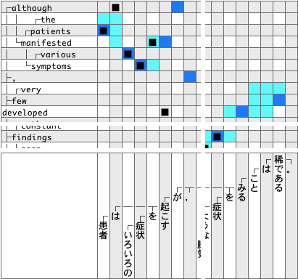
 | Precision | Recall | AER
GIZA++ & grow | 82.04 | 81.18 | 18.37
Nakazawa+, 2011 | 89.63 | 79.68 | 15.17
・・・
・・・
Sure
・・・
Possible
System
Output

Slide 6
Related Work
Insert pseudo nodes for function words heuristically [Isozaki+, 2010]
Delete alignments for some function words after GIZA++ [Wu+, 2011]
Ad-hoc and need language-pair dependent rules for the insertion or deletion

Slide 7
Motivation
Two types of function words
Type 1: counterparts exist in the other side
less problematic, can be handled as content words
Type 2: counterparts do not exist in the other side
problematic, we call them “unique function words”
Proposed
bilingually generate treelet pairs for content words and Type 1 function words
monolingually derive Type 2, unique function words

Slide 8
Case Study of Alignment
He*
彼*
ran*
は
(topic marker)
slowly*
公園*
in
で
NULL
the
ゆっくり*
park*
走った*
Some function words are also easy to align
Content words are easy to align
Some function words are incorrectly aligned
Derive function words to avoid alignment errors

Slide 9
Important Notice
We do not explicitly distinguish between content words and function words in the model
All the words are treated in the same manner
The proposed model can naturally derive unique function words

Slide 10
Model Overview

Slide 11
Generative Story of the Model
The
C₁
medical*
治療*
treatment*
かも
C₂
しれ
may
ない
not
C₃
ない
に
より
(by)
change*
C₄
変化*
し
(light verb)
the
C₅
体重*
weight*
は
(topic marker)
Choose a number of components
Generate each of core treelet pairs bilingually
Derive treelets monolingually

Slide 12
Generative Story of the Model
体重*
The
は
(topic marker)
medical*
治療*
treatment*
に
より
(by)
may
変化*
not
し
(light verb)
change*
ない
the
weight*
かも
しれ
ない
Choose a number of components
Generate each of core treelet pairs bilingually
Derive treelets monolingually
Combine treelets so as to create sentences

Slide 13
Model in Formal
Generative story of joint probability model
Choose a number of components
Generate each of core treelet pairs bilingually
Derive treelets monolingually
Combine treelets so as to create sentences
Formally
See proceedings or Nakazawa+, 2011
Step 1
Step 4
Step 2,3

Slide 14
Bilingual Generation and Monolingual Derivation
Core treelet pair is generated from unknown distribution ~ Dirichlet process
Each core treelet and derives sets of treelets and monolingually
The number of derivations: geometric distribution
Derivation probability: estimated from large monolingual corpora

Slide 15
Derivation Probability
Derivation is conditioned on the word which is connected to
e.g.
Not only the lexicalized probability, but also POS-based probability
e.g.
example
The
medical
treatment

Slide 16
Derivation Probability
Derivation probability is estimated from large monolingual corpus
denotes the frequency of connected to
Example of counting the derivations
The
medical
treatment
治療*
may
に
not
より
change

Slide 17
Natural Distinction
 | Content Words | Function Words
often surrounded by | function words | content words
vocabulary size | very large | small
The number of derivation patterns from function words becomes larger
Probability of each pattern from function words becomes much smaller
Derivations from function words rarely occurs
Derivations of function words from content words are prefferred

Slide 18
Example of Probability Calculation
θ_{T}（〈weight, 体重〉） ×
φ_{weight}（the） × φ_{体重}（は）
体重*
The
は
(topic marker)
medical*
治療*
θ_{T}（〈medical treatment, 治療〉）×
φ_{medical treatment}（The）
treatment*
に
より
(by)
may
θ_{T}（〈change, 変化〉） ×
φ_{変化}（に より） × φ_{変化}（し）
変化*
not
し
(light verb)
change*
the
ない
θ_{T}（〈not, なかった〉）
weight*
かも
θ_{T}（〈may, かも しれ ない〉）
しれ
ない
* Ignoring which parameterizes the number of derivations

Slide 19
Model Training

Slide 20
Gibbs Sampling
Initialization
Create heuristic phrase alignment like ‘grow-diag-final-and’ on dependency trees using results from GIZA++
Refine the model by changing the alignment
Operators: SWAP, TOGGLE, EXPAND, MERGE, BOUNDARY, TRANSFORM

Slide 21
SWAP Operator
Swap the counterparts of two alignments
SWAP-1
・・・
・・・
・・・
・・・
SWAP-2
NULL
・・・
・・・
NULL

Slide 22
TOGGLE Operator
Remove existing alignment or add new alignment
NULL
NULL

Slide 23
EXPAND Operator
Expand or contract an aligned treelet
EXPAND (as core)
NULL
EXPAND (as derivation)

Slide 24
BOUNDARY Operator
Change the boundary between two aligned treelets

Slide 25
TRANSFORM Operator
Change the attributes of a word between core and derivation

Slide 26
MERGE Operator
Include another alignment as derivations or exclude derivations as another alignment

Slide 27
Alignment & Translation Experiment

Slide 28
Alignment Experiment
Training: En-Ja paper abst. 1M sentence pairs
Testing: 500 sentence pairs with Sure and Possible alignments
Maximum size of a derivation treelet: 3
Measure: Precision, Recall, Alignment Error Rate (AER)
Base analyzer: nlparser (En), JUMAN+KNP (Ja)
Monolingual corpora: Web 550M sentences

Slide 29
Experimental Results
Alignment Model | Precision | Recall | AER
GIZA++ & grow | 83.00 | 83.01 | 16.99
Nakazawa+, 2011 | 88.59 | 83.78 | 13.66
Proposed | 87.83 | 85.81 | 13.06
Proposed, evaluating core only | 90.51 | 84.49 | 12.32

Slide 30
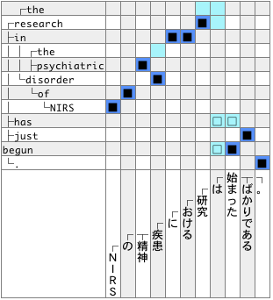
Improved Example
Proposed
Sure
Possible
Core
Derivation

Slide 31
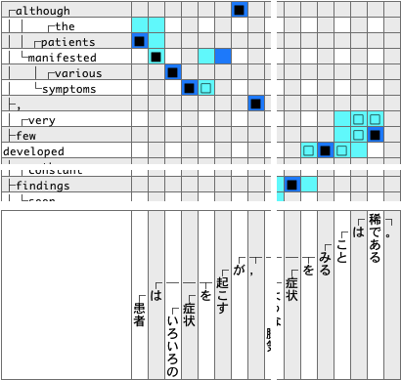
Improved Example
Proposed
・・・
・・・
・・・
・・・
・・・
Sure
・・・
Possible
Core
Derivation

Slide 32
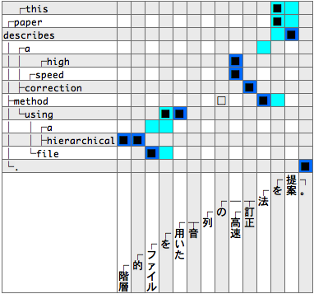
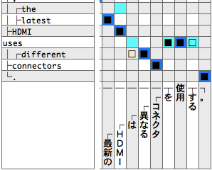
Error Analysis
・・・
・・・
noise of parallel sentence
parsing error

Slide 33
Translation Experiment
Training: Identical to the alignment experiment
Direction: En -> Ja and Ja -> En
Tuning: 500 sentences
Testing: 500 sentences
Decoder: Joshua (hierarchical PSMT) with default settings
Measure: BLEU

Slide 34
Experimental Results
Alignment Model | AER | BLEU En -> Ja | BLEU Ja -> En
GIZA++ & grow | 16.99 | 23.84 | 17.75
Nakazawa+, 2011 | 13.66 | 24.16 | 17.83
Proposed | 13.06 | 24.55† | 18.46†‡
Proposed, using core only | 12.32 | 24.45 | 17.76
†: significant difference from GIZA++ (p < 0.05)
‡: significant difference from Nakazawa+, 2011 (p < 0.05)

Slide 35
Conclusion
Bilingual generation and monolingual derivation
Handle unique function words properly
Good estimation of bilingual generation
e.g. θ(<weight, 体重>) instead of θ(<weight, 体重 は>)
Derivations are acquired from large monolingual corpora
Reduce alignment errors of function words and improve translation quality

Slide 36
Future Work
Word-class-based derivation
e.g. “patient who …”
Handling light verb construction
e.g. “introduction is given”
Conduct experiments on other language pairs
Tree-based decoding

Slide 37
Thank you for your attention!!
Acknowledgement
This work was partially supported by Yahoo Japan Corporation

