Slide 1
Similar Southeast Asian Languages: Corpus-Based Case Study on Thai-Laotian and Malay-Indonesian
Chenchen Ding, Masao Utiyama, Eiichiro Sumita
Advanced Translation Technology Laboratory, ASTREC, NICT, Japan

Slide 2
Motivation
For similar languages
Specific and efficient approaches can be designed
Techniques on well-studied languages can be applied to low-resourced ones
How to measure the similarity
Scripts: related or comparable writing systems → similar letters
Vocabulary: etymologically related words → similar spellings
Syntax: phrase / sentence structure → similar word orders

Slide 3
Outline
Asian language treebank (ALT) project
Similar languages and related processing
Investigation and experiments
Conclusion and future works

Slide 4
Motivation of Asian Language Treebank
Compared with European languages
Most Asian languages are low-resourced and understudied
→ NLP techniques cannot be developed and applied
ALT can facilitate
Tokenization / POS tagging / Parsing
Cross-lingual processing
→ Establish a solid basis for Asian language processing

Slide 5
Details of Asian Language Treebank
Treebanks for six Asian languages and English
Burmese, Indonesian, Japanese, Khmer, Malay, Vietnamese
April 2016 -- March 2019
Candidate languages in future
Laotian, Tagalog, Thai
All the raw parallel data are available
http://www2.nict.go.jp/astrec-att/member/mutiyama/ALT/

Slide 6
Similar Languages in ALT
URL
en.wikinews.org/wiki/2007_Rugby_World_Cup:_Italy_31_-_5_Portugal
English sentences
Italy have defeated Portugal 31-5 in Pool C of the 2007 Rugby World Cup at Parc des Princes, Paris, France.
…

Slide 7
Similar Languages in ALT
URL
en.wikinews.org/wiki/2007_Rugby_World_Cup:_Italy_31_-_5_Portugal
Indonesian and Malay translations
Italia berhasil mengalahkan Portugal 31-5 di grup C dalam Piala Dunia Rugby 2007 di Parc des Princes, Paris, Perancis.
…
Itali telah mengalahkan Portugal 31-5 dalam Pool C pada Piala Dunia Ragbi 2007 di Parc des Princes, Paris, Perancis.
…

Slide 8
Similar Languages in ALT
URL
en.wikinews.org/wiki/2007_Rugby_World_Cup:_Italy_31_-_5_Portugal
Indonesian and Malay translations
Italia berhasil mengalahkan Portugal 31-5 di grup C dalam Piala Dunia Rugby 2007 di Parc des Princes, Paris, Perancis.
…
Itali telah mengalahkan Portugal 31-5 dalam Pool C pada Piala Dunia Ragbi 2007 di Parc des Princes, Paris, Perancis.
…

Slide 9
Similar Languages in ALT
URL
en.wikinews.org/wiki/2007_Rugby_World_Cup:_Italy_31_-_5_Portugal
Laotian and Thai translations
ອິຕາລີໄດ້ເສຍໃຫ້ປ໊ອກຕຸຍການ31ຕໍ່5ໃນພູລCຂອງການແຂ່ງຂັນຣັກບີ້ລະດັບໂລກປີ2007ທີ່ປາກເດແພຣັງປາຣີປະເທດຝຣັ່ງ.
…
อิตาลีได้เอาชนะโปรตุเกสด้วยคะแนน31ต่อ5ในกลุ่มcของการแข่งขันรักบี้เวิลด์คัพปี2007ที่สนามปาร์กเดแพร็งส์ที่กรุงปารีสประเ
…

Slide 10
Similar Languages in ALT
URL
en.wikinews.org/wiki/2007_Rugby_World_Cup:_Italy_31_-_5_Portugal
Laotian and Thai translations
ອິຕາລີໄດ້ເສຍໃຫ້ປ໊ອກຕຸຍການ31ຕໍ່5ໃນພູລCຂອງການແຂ່ງຂັນຣັກບີ້ລະດັບໂລກປີ2007ທີ່ປາກເດແພຣັງປາຣີປະເທດຝຣັ່ງ.
…
อิตาลีได้เอาชนะโปรตุเกสด้วยคะแนน31ต่อ5ในกลุ่มcของการแข่งขันรักบี้เวิลด์คัพปี2007ที่สนามปาร์กเดแพร็งส์ที่กรุงปารีสประเ
…

Slide 11
Processing Similar Languages in NLP
Translation between Catalan and Spanish
Can we translate letters? D. Vilar et al., 2007, WMT
Translation between Japanese and Korean
The last years’ WAT
Character-based processing
Apply SMT techniques on Japanese to Burmese
Empirical dependency-based head finalization for statistical Chinese-, English-, and French-to-Myanmar (Burmese) MT. C. Ding et al. 2014, IWSLT

Slide 12
Two Southeast Asian Language Pairs
Thai-Laotian
Tonal languages from the Tai-Kadai language family, mutually intelligible
Abugida writing systems
Etymologically related words
Isolating in morphology, head-initial in syntax
Malay-Indonesian
From Austronesian languages family, mutually intelligible
Using Latin scripts
“Different registers of one language”

Slide 13
Data and Pre-processing
Raw translations from ALT
Sentences : train / dev / test → 18,000 / 1,000 / 1,000
Tokens:
Simple tokenization for Malay and Indonesian
Punctuation marks detached
Unbreakable unit segmentation for Thai and Laotian
Dependent diacritics attached to independent letters

Slide 14
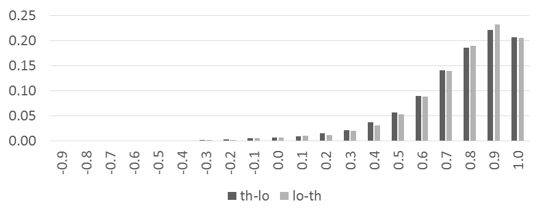
Word Order
Kendall’s tau on Thai and Laotian

Slide 15
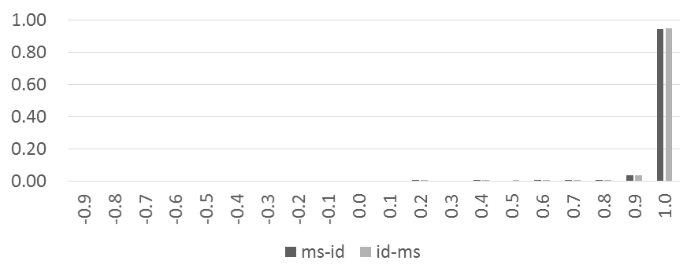
Word Order
Kendall’s tau on Malay and Indonesian

Slide 16
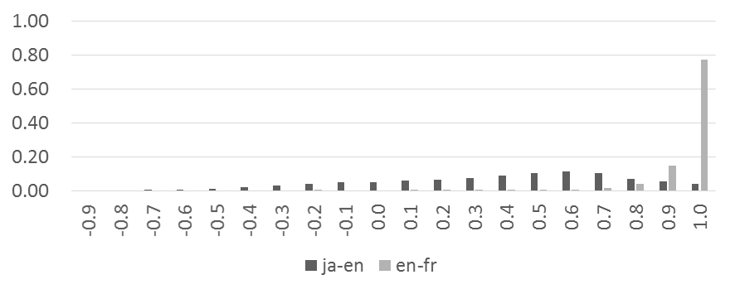
For Comparison
Kendall’s tau on Japanese-English and English-French

Slide 17
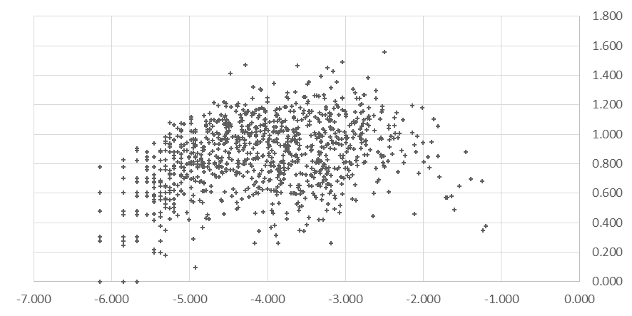
Uncertainty in Token Correspondence
X-axis: log probability of Thai tokens
Y-axis: Entropy on corresponding Laotian tokens

Slide 18
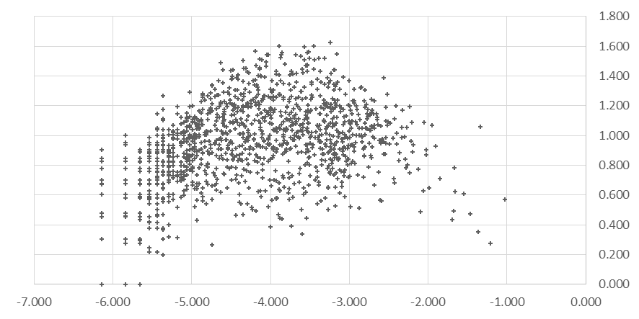
Uncertainty in Token Correspondence
X-axis: log probability of Laotian tokens
Y-axis: Entropy on corresponding Thai tokens

Slide 19
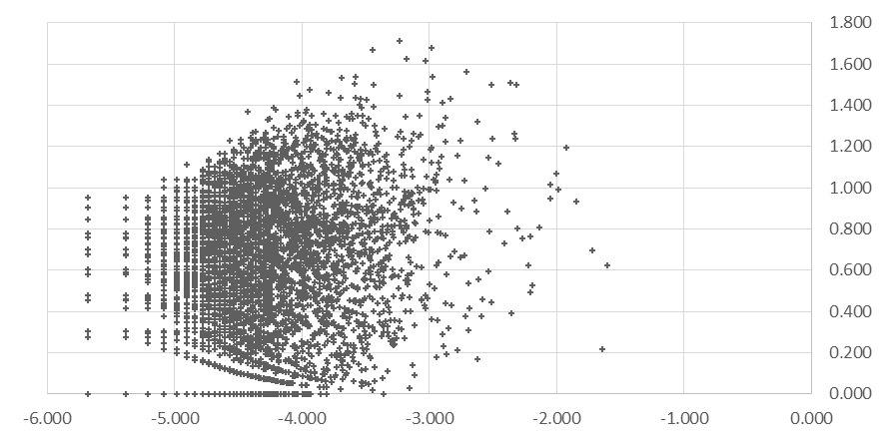
Uncertainty in Token Correspondence
X-axis: log probability of Malay tokens
Y-axis: Entropy on corresponding Indonesian tokens

Slide 20
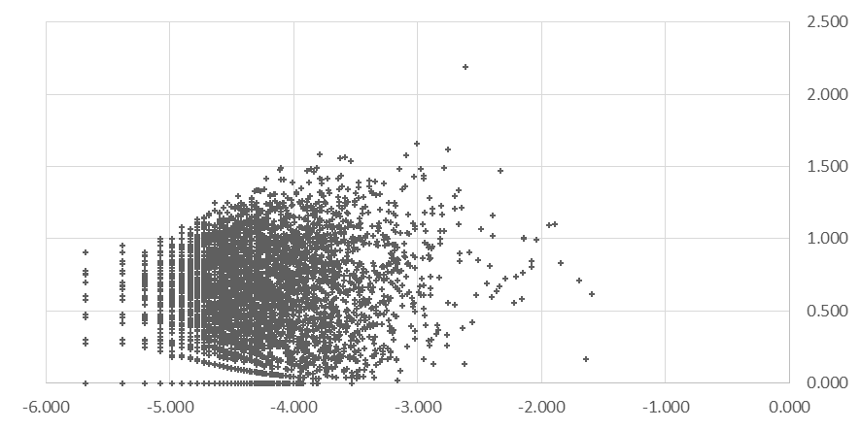
Uncertainty in Token Correspondence
X-axis: log probability of Indonesian tokens
Y-axis: Entropy on corresponding Malay tokens

Slide 21
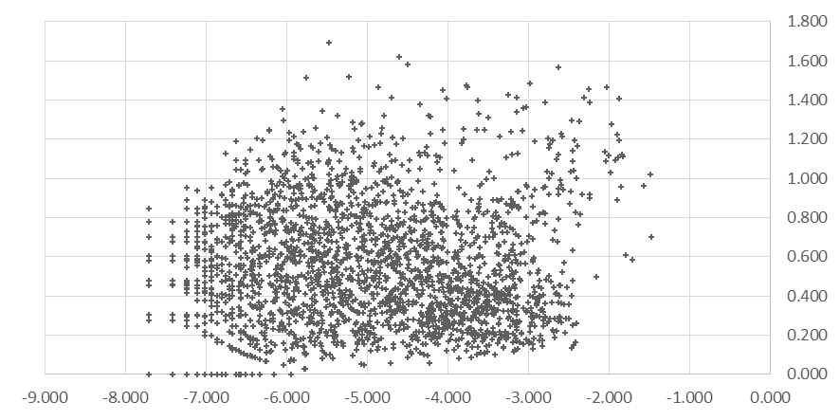
For Comparison
X-axis: log probability of Japanese characters
Y-axis: Entropy on corresponding Korean characters

Slide 22
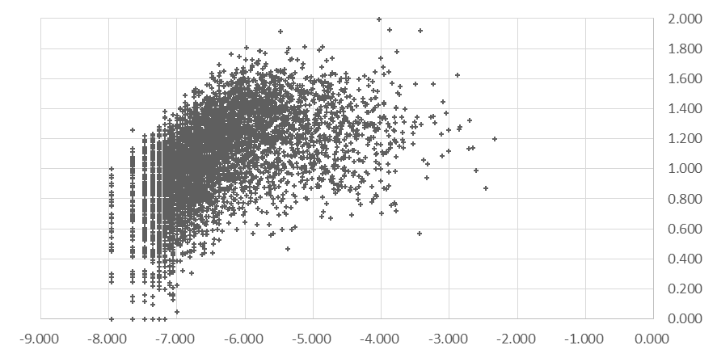
For Comparison
X-axis: log probability of Japanese tokens
Y-axis: Entropy on corresponding English words

Slide 23
Experimental Results from SMT
Moses PB-based SMT
The parallel data in ALT is not sufficient for a practical system
→ Experiments to investigate the reordering requirement in translation

Slide 24
Conclusion and Future Work
The similarities between Thai-Laotian and Malay-Indonesian
Have been investigated in this study
Based on the ALT data
→ The Thai-Laotian pair is similar to Japanese-Korean pair
→ The Malay-Indonesian pair is extremely similar in word order
Future Work
Harmonious annotation of the language pairs in corpus construction
Unified techniques for NLP tasks / applications

