Slide 1
An Efficient and Effective Online Sentence Segmenter for Simultaneous Interpretation
Xiaolin Wang Andrew Finch
Masao Utiyama Eiichiro Sumita
Advanced Translation Research and Development Promotion Center
National Institute of Information and Communication Technology, Japan
{xiaolin.wang, andrew.finch, mutiyama, eiichiro.sumita}@nict.go.jp

Slide 2
What is Simultaneous Interpretation?
Machine translation normally translates text given by users.
Spoken language translation translates text from automatic speech recognition systems.
Simultaneous interpretation performs spoken language translation in an online manner.
Advantage:
Much less delay: Users can hear the translation almost as soon as speakers finish a sentence or sub-sentence.
Ideal form of bridging the gap of languages.

Slide 3
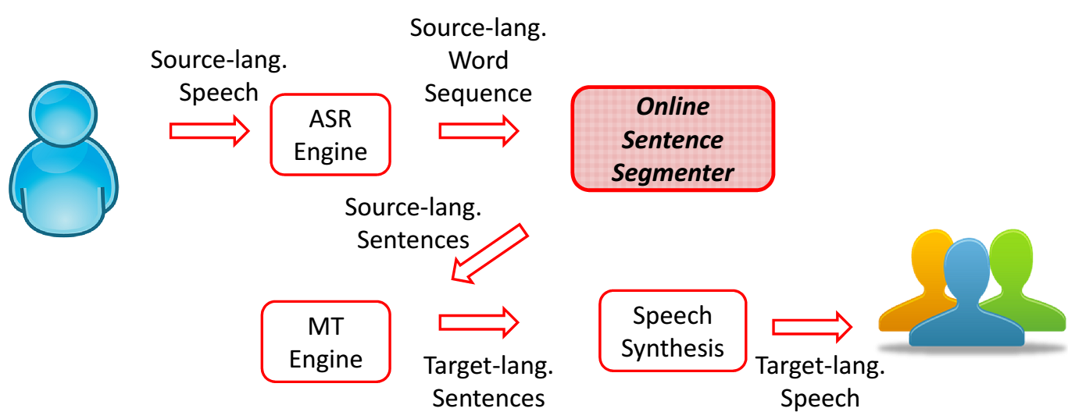
Online Sentence Segmenter
Online Sentence Segmentation is one of many approaches to simultaneous interpretation
Sentence segmenters bridge the gap of ASR and MT by segmenting stream of words into sentences

Slide 4
Our Contribution
Most existent segmentation methods
Require a long context of future words
Computationally expensive
We propose a new method
Efficient:
Computationally simple
Less latency : fewer future words
Effective:
End-to-end performance: optimized against BLEU
Scalable for industry
Provide simultaneous interpretation service for every one

Slide 5
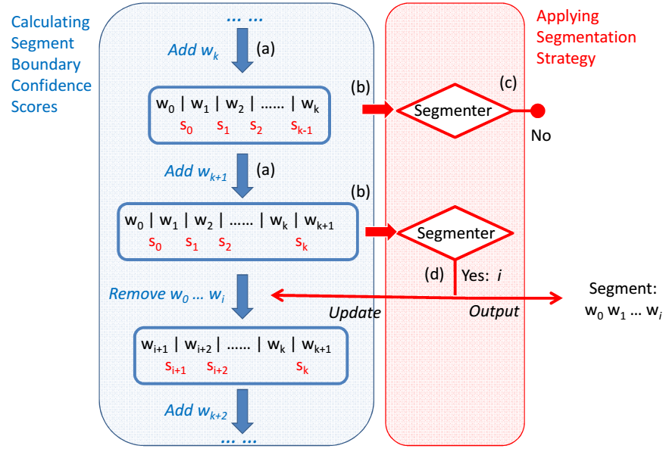
Method: Framework

Slide 6
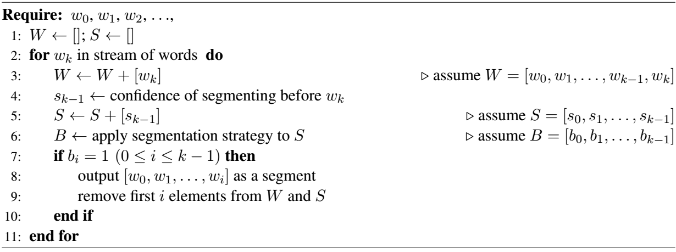
Method: Framework(II)
Confidence of segmenting
Segmentation Strategy

Slide 7
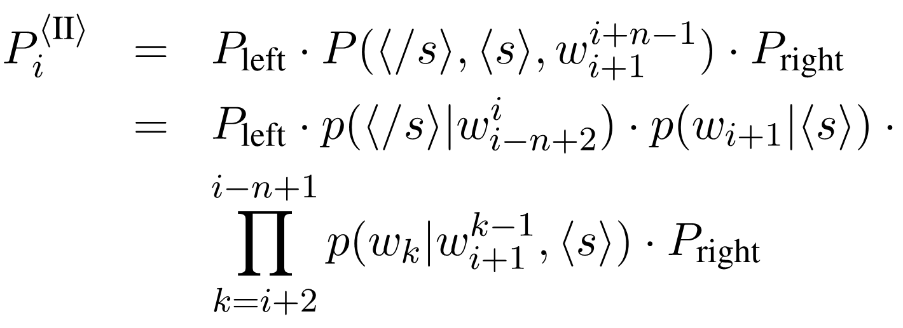
Method: Segmenting Confidence
Hypothesis I: no boundary after word w_{i}
Hypothesis II: break after word w_{i}

Slide 8
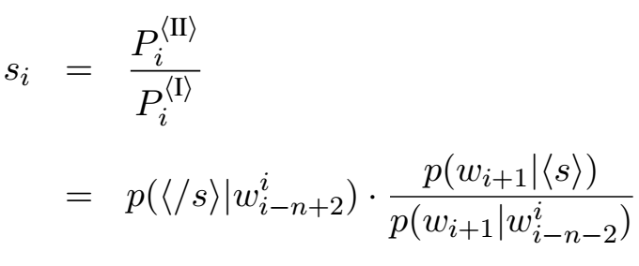
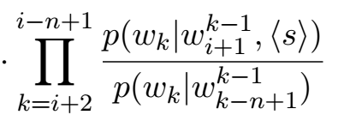
Method: Segmenting Confidence(II)
The confidence score is defined as the ratio of the two probabilities

Slide 9
Method: Segmenting Confidence (III)
Delay is determined by the order of n-gram language models.
Delay can be empirically reduced to one word through an approximation.
(Please refer to the experiments)

Slide 10
Method: Segmentation Strategy
Threshold-based Segmentation Strategy
Latency-based Segmentation Strategy

Slide 11
Method: Segmentation Strategy (II)
Threshold-Latency-based strategy
A hybrid strategy
Aim at lowest latency

Slide 12
Experiments: Settings
Translation between Japanese - English
Simulate ASR output
Remove punctuations
Concatenate a random number (1 to 10) of sentences into one utterance
Performance measurement
Efficiency: average latency per source words
Effectiveness: BLEU

Slide 13
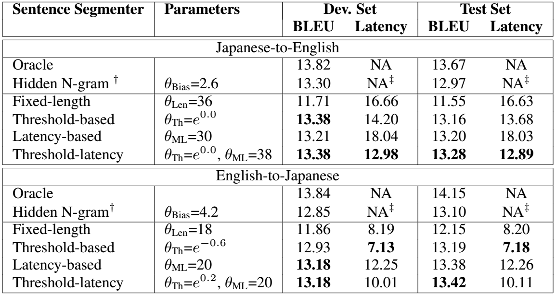
Experiments: Results
Using different sentence segmenters
† SRILM toolkit.
‡The method is not online since it operates on a whole sequence of words

Slide 14
Experiments: Results (II)
Proposed methods are
much better than the trivial method of fixed-length segmentation,
comparable to the offline method (hidden N-gram models)
The hybrid method consistently outperforms the two basic ones.
BLEU of the threshold-based segmenter compared to that of latency-based segmenter is
Lower in English-to-Japanese
Almost equal in Japanese-to-English
Because Japanese has end-of-sentence indicators such as “ます (MA SU)” and “です (DE SU)”

Slide 15
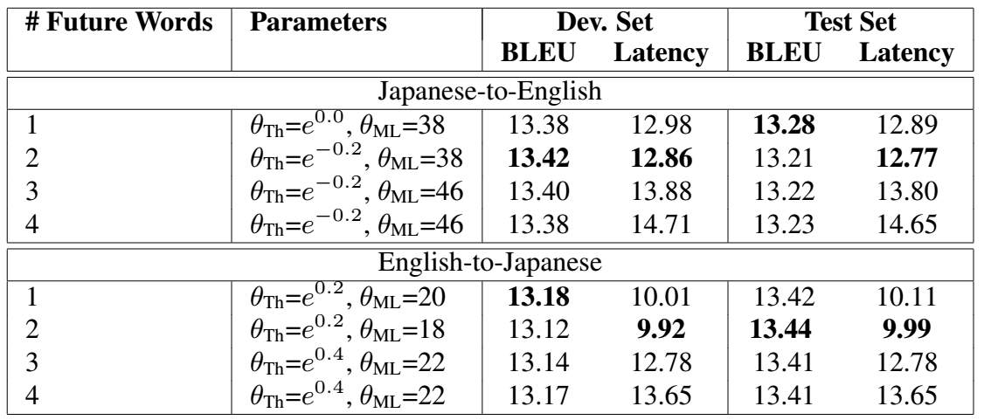
Experiments: Results (II)
Using different numbers of future words
One future word is sufficient.

Slide 16
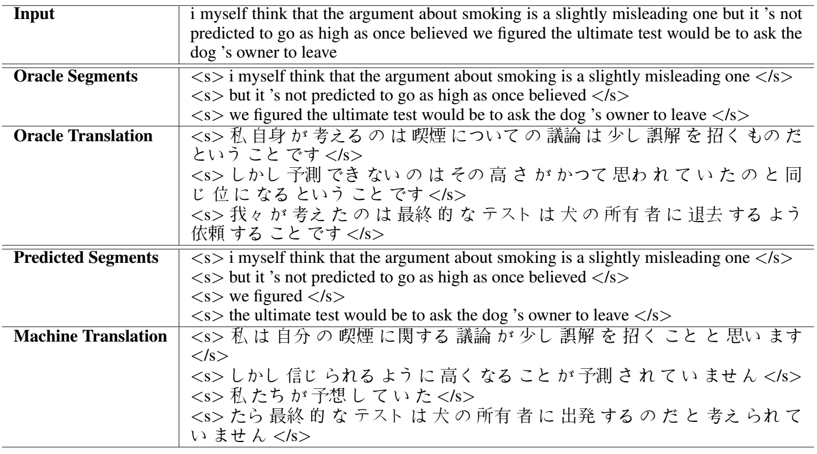
An Example

Slide 17
Conclusions
We proposed a practical solution to simultaneous interpretation, consists of
a confidence score for boundaries
a segmentation strategy
The method achieves
faster speed
better translation quality
This is a First Step. Next is
Neural network (NN) segmentation model
Native NN simultaneous interpretation model
…
Welcome to the real-world demonstration at
December 13th, 11:00 – 12:30, Room 1004-1007
Demo Session 1, COLING 2016 ☺
Thank You

